Slide 1
The LHCb Experiment Control System:
On the path to full automation

Slide 2
The Experiment Control System
Is in charge of the Control and Monitoring of all areas of the experiment
DCS Devices (HV, LV, GAS, Cooling, etc.)
Detector Channels
L0
TFC
Front End Electronics
Experiment Control System
Readout Network
HLT Farm
Storage
Monitoring Farm
DAQ
External Systems (LHC, Technical Services, Safety, etc)
Notes:
In charge of the Control and Monitoring of:
Data Acquisition System
FE Electronics, Readout, Event Building, etc.
Timing and Trigger Systems
Timing & Fast Control (TFC)
L0 Trigger
High Level Trigger Farm
Detector Control System
Gas, High Voltages, Low Voltages, Temperatures...
Experimental Infrastructure
Cooling, Ventilation, Electricity distribution, ...
Interaction with the outside world
Magnet, Accelerator system, Safety system, etc.

Slide 3
Homogeneity
Same architecture and same tools used throughout the Control System.
Generic Architecture:
ECS
INFR.
DCS
TFC
DAQ
HLT
LHC
SubDet1 DCS
SubDet2 DCS
…
SubDetN DCS
SubDet1 DAQ
SubDet2 DAQ
…
SubDetN DAQ
Status & Alarms
Commands
SubDet1 LV
SubDet1 TEMP
SubDet1 GAS
SubDet1 FEE
SubDet1 RO
Building Blocks:
Control Unit
LV Dev1
LV Dev2
…
LV DevN
FEE Dev1
FEE Dev2
…
FEE DevN
Device Unit

Slide 4
The Control Framework
The JCOP* Framework is based on:
SCADA System - PVSSII for:
Device Description (Run-time Database)
Device Access (OPC, Profibus, drivers) +DIM
Alarm Handling (Generation, Filtering, Masking, etc)
Archiving, Logging, Scripting, Trending
User Interface Builder
Alarm Display, Access Control, etc.
SMI++ providing:
Abstract behavior modeling (Finite State Machines)
Automation & Error Recovery (Rule based system)
* – The Joint COntrols Project (between the 4 LHC exp. and the CERN Control Group)
Device Units
Control Units

Slide 5
Device Units
Device Unit
Provide access to “real” devices:
The FW provides interfaces to all necessary types of devices:
LHCb devices: HV channels, Read Out boards, Trigger processes running in the HLT farm or Monitoring tasks for data quality, etc.
External devices: the LHC, a gas system, etc.
Each device is modeled as a Finite State Machine:
It’s main interface to the outside world is a “State” and a (small) set of “Actions”.

Slide 6
Hierarchical control
Control Unit
Each Control Unit:
Is defined as one or more Finite State Machines
It’s interface to outside is also a state and actions
Can implement rules based on its children’s states
In general it is able to:
Include/Exclude children (Partitioning)
Excluded nodes can run is stand-alone
Implement specific behaviour & Take local decisions
Sequence & Automate operations
Recover errors
User Interfacing
Present information and receive commands
DCS
…
Tracker DCS
Muon DCS
Muon LV
Muon GAS

Slide 7
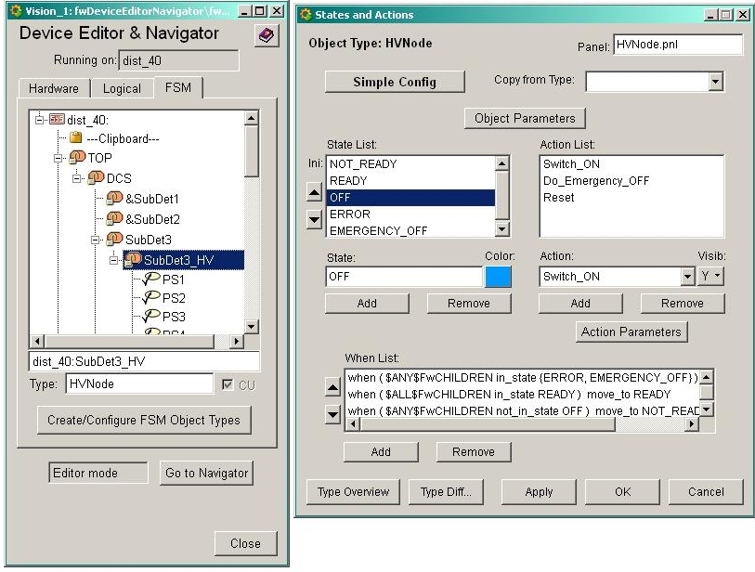
FW – Graphical Editor
SMI++ Objects States & Actions
Parallelism, Synchronization
Asynchronous Rules

Slide 8
Operation Domains
DCS Domain Equipment operation related to a running period (Ex: GAS, Cooling)
HV Domain Equipment operation related to the LHC State (Ex: High Voltages)
ERROR
Recover
Switch_OFF
NOT_READY
ERROR
Recover
NOT_READY
OFF
OFF
Go_STANDBY1
Switch_ON
Switch_OFF
RAMPING_STANDBY1
READY
STANDBY1
Go_STANDBY2
DAQ Domain Equipment operation related to a “RUN” (Ex: RO board, HLT process)
RAMPING_STANDBY2
STANDBY2
Go_READY
RAMPING_READY
ERROR
Recover
UNKNOWN
READY
NOT_READY
FSM templates distributed to all Sub-detectors
All Devices and Sub-Systems have been implemented using one of these templates
Configure
CONFIGURING
Reset
READY
Start
Stop
RUNNING

Slide 9
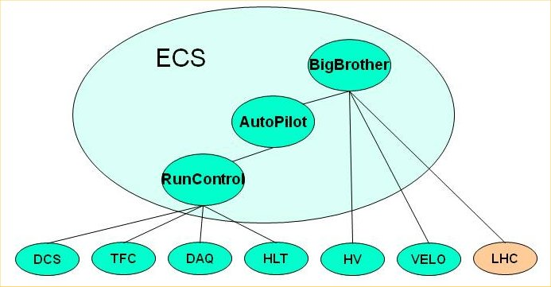
ECS - Automation
Some Examples:
HLT Control (~1500 PCs)
Automatically excludes misbehaving PCs (within limits)
Can (re)include PCs at run-time (they get automatically configured and started)
RunControl
Automatically detects and recovers SubDetector desynchronizations
Can Reset SDs when problems detected by monitoring
AutoPilot
Knows how to start and keep a run going from any state.
BigBrother
Based on the LHC state:
Controls SD Voltages
VELO Closure
RunControl

Slide 10
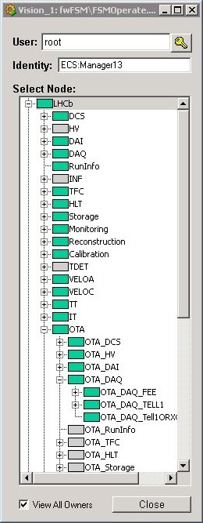
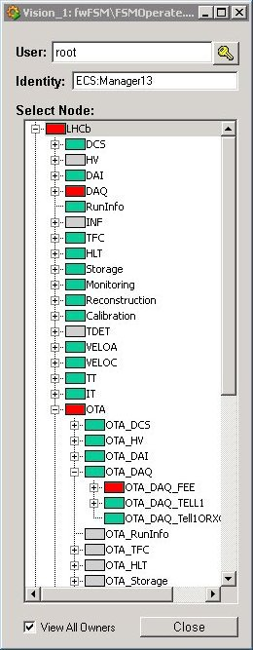
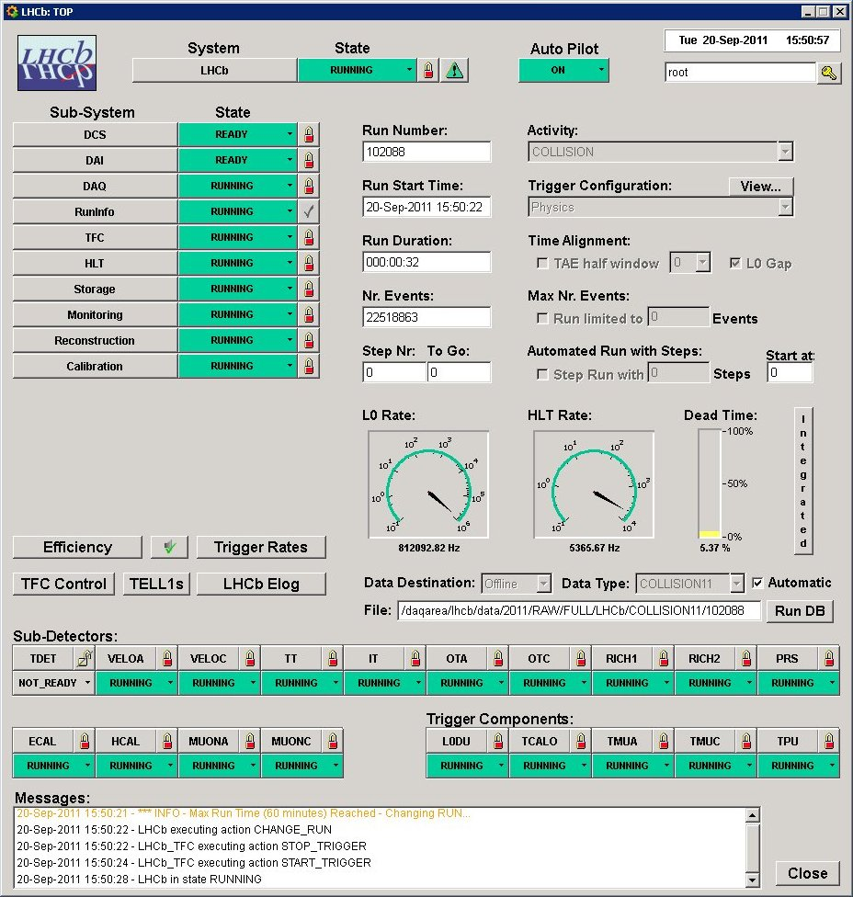
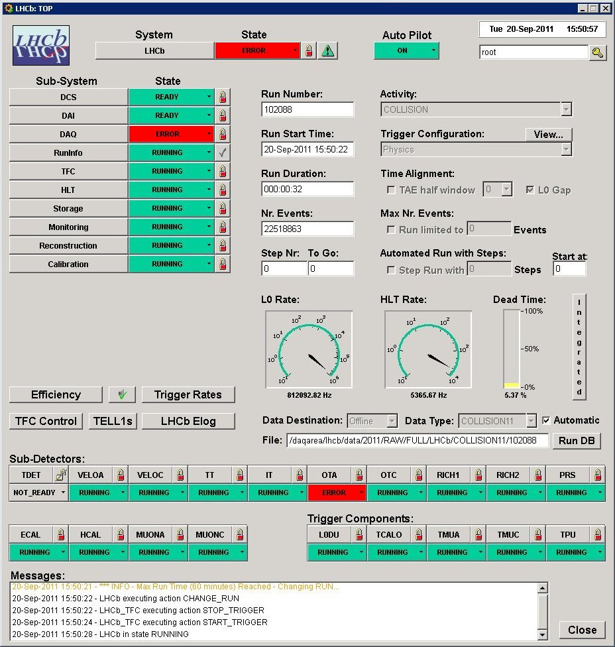
Run Control
Matrix
Activity
Domain
X
Sub-Detector
Used for Configuring all Sub-Systems

Slide 11
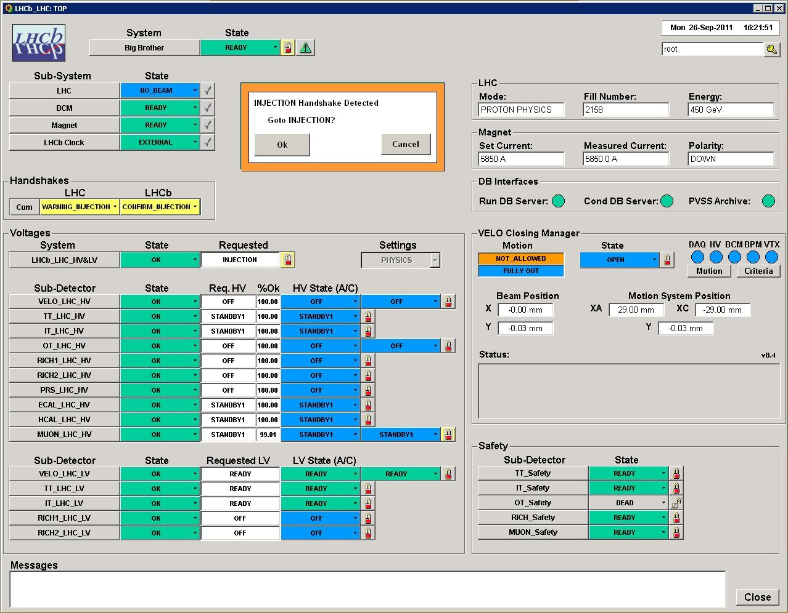
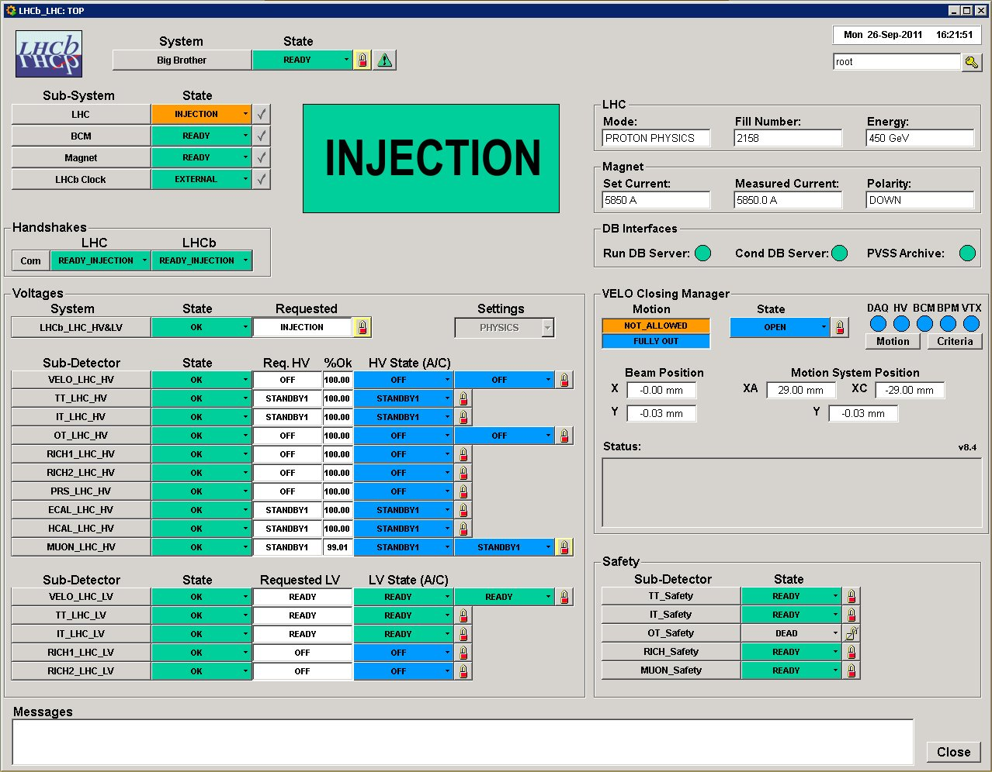
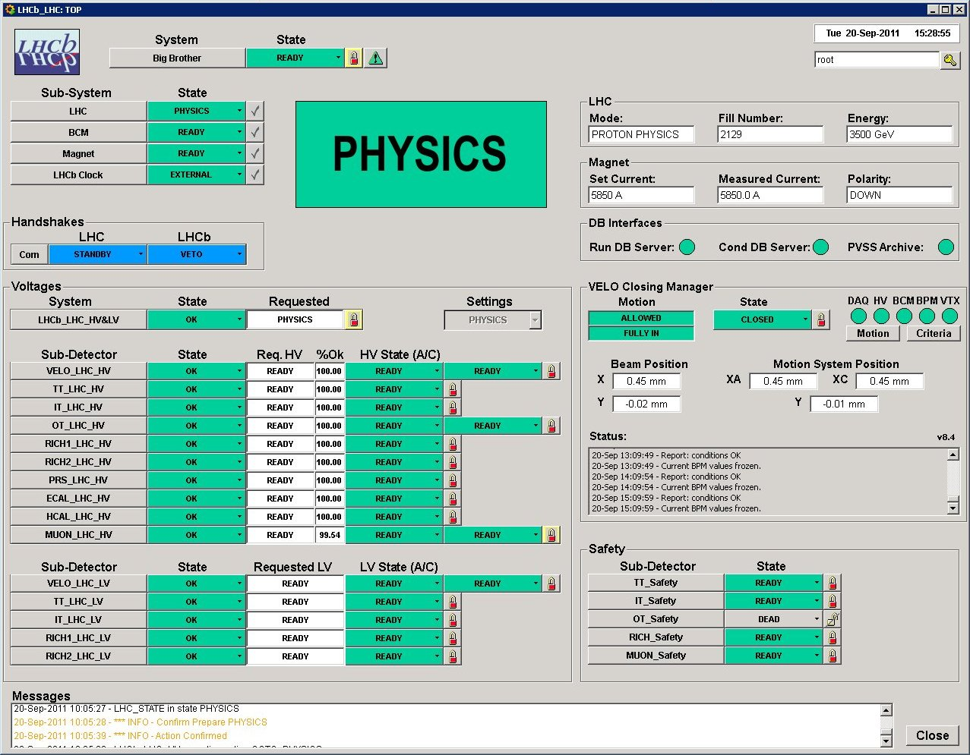
LHCb Operations
Two operators on shift:
Data Manager
Shift Leader has 2 views of the System:
Run Control
Big Brother
Big Brother
Manages LHC dependencies:
SubDetector Voltages
VELO Closing
Run Control

Slide 12
ECS: Some numbers
Size of the Control Tree:
Distributed over ~150 PCs
~100 Linux (50 for the HLT)
~ 50 Windows
>2000 Control Units
>50000 Device Units
Run Control Timing
Cold Start to Running: 4 minutes
Configure all Sub-detectors, Start & Configure ~40000 HLT processes (always done well before PHYSICS)
Stop/Start Run: 6 seconds
ECS
HV
DCS
TFC
DAQ
HLT
LHC
…
…
SubDet1 DCS
SubDetN DCS
SubDet1 DAQ
SubDetN DAQ

Slide 13
Conclusions
LHCb has designed and implemented a coherent and homogeneous control system
The Experiment Control System allows to:
Configure, Monitor and Operate the Full Experiment
Run any combination of sub-detectors in parallel in standalone
Some of its main features:
Partitioning, Sequencing, Error recovery, Automation
Come from the usage of SMI++ (integrated with PVSS)
LHCb operations now almost completely automated
Operator task is easier (basically only confirmations)
DAQ Efficiency improved to ~98%

