Slide 1
The LHCb Experiment Control System:
Automation concepts & tools

Slide 2
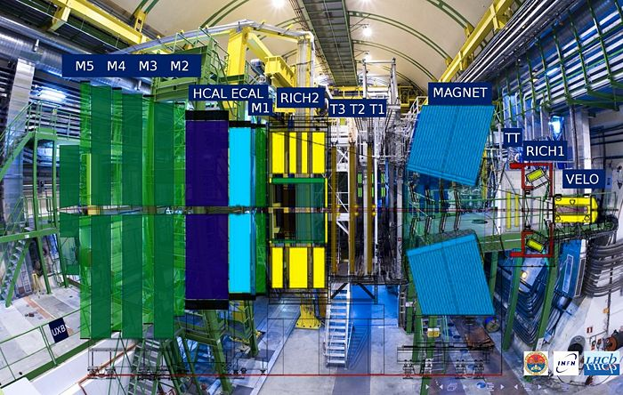
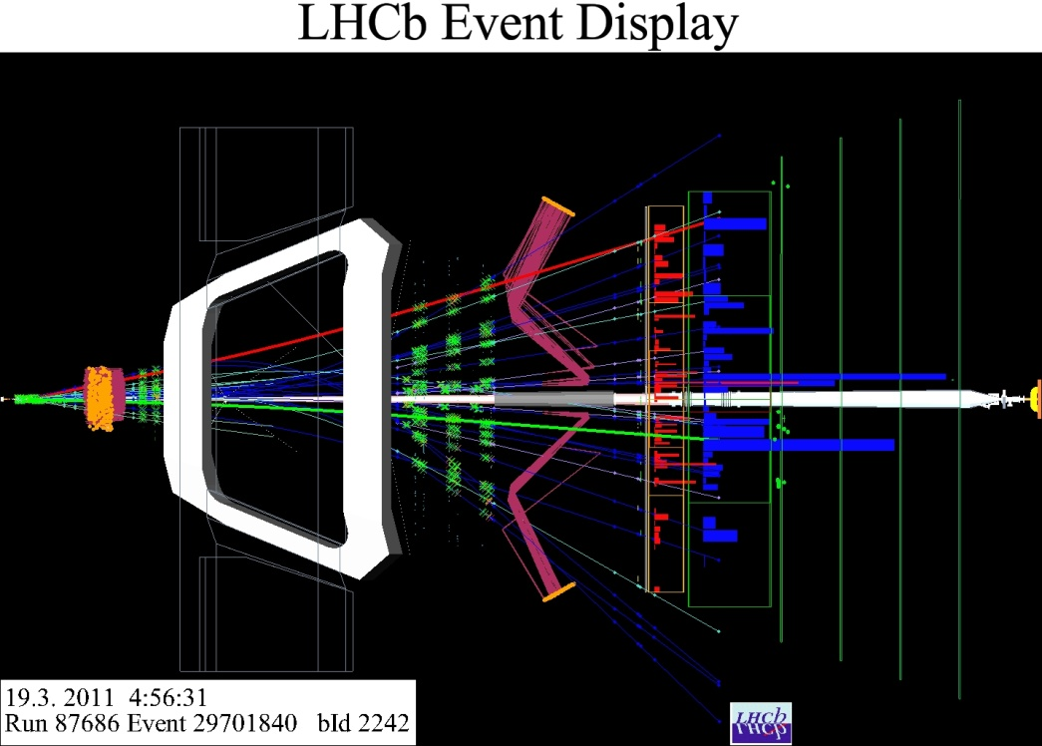
LHCb Experiment
LHCb is one of the four LHC experiments
Specialized in detecting differences between matter and anti-matter
Several sub-detectors
p-p collisions every 25 ns
Collected by a large Data Acquisition System
Filtered by the Trigger System (~1500 PCs)

Slide 3
The Experiment Control System
Is in charge of the Control and Monitoring of all areas of the experiment
DCS Devices (HV, LV, GAS, Cooling, etc.)
Detector Channels
L0
TFC
Front End Electronics
Experiment Control System
Readout Network
HLT Farm
Storage
Monitoring Farm
DAQ
External Systems (LHC, Technical Services, Safety, etc)
Notes:
In charge of the Control and Monitoring of:
Data Acquisition System
FE Electronics, Readout, Event Building, etc.
Timing and Trigger Systems
Timing & Fast Control (TFC)
L0 Trigger
High Level Trigger Farm
Detector Control System
Gas, High Voltages, Low Voltages, Temperatures...
Experimental Infrastructure
Cooling, Ventilation, Electricity distribution, ...
Interaction with the outside world
Magnet, Accelerator system, Safety system, etc.

Slide 4
Some Requirements
Large number of devices/IO channels
Need for Distributed Hierarchical Control
De-composition in Systems, sub-systems, … , Devices
Local decision capabilities in sub-systems
Large number of independent teams and very different operation modes
Need for Partitioning Capabilities (concurrent usage)
High Complexity & Non-expert Operators
Need for Full Automation of:
Standard Procedures
Error Recovery Procedures
And for Intuitive User Interfaces

Slide 5
Design Steps
In order to achieve an integrated System:
Promoted HW Standardization (so that common components could be re-used)
Ex.: Mainly two control interfaces to all LHCb electronics
Credit Card sized PCs (CCPC) for non-radiation zones
A serial protocol (SPECS) for electronics in radiation areas
Defined an Architecture
That could fit all areas and all aspects of the monitoring and control of the full experiment
Provided a Framework
An integrated collection of guidelines, tools and components that allowed the development of each sub-system coherently in view of its integration in the complete system

Slide 6
Generic SW Architecture
ECS
INFR.
DCS
TFC
DAQ
HLT
LHC
…
…
SubDet1 DCS
SubDet2 DCS
SubDetN DCS
SubDet1 DAQ
SubDet2 DAQ
SubDetN DAQ
Status & Alarms
Commands
SubDet1 LV
SubDet1 TEMP
SubDet1 GAS
SubDet1 FEE
SubDet1 RO
Legend:
Control Unit
…
…
Device Unit
LV Dev1
LV Dev2
LV DevN
FEE Dev1
FEE Dev2
FEE DevN

Slide 7
The Control Framework
The JCOP* Framework is based on:
SCADA System - PVSSII for:
Device Description (Run-time Database)
Device Access (OPC, Profibus, drivers) +DIM
Alarm Handling (Generation, Filtering, Masking, etc)
Archiving, Logging, Scripting, Trending
User Interface Builder
Alarm Display, Access Control, etc.
SMI++ providing:
Abstract behavior modeling (Finite State Machines)
Automation & Error Recovery (Rule based system)
* – The Joint COntrols Project (between the 4 LHC exp. and the CERN Control Group)
Device Units
Control Units

Slide 8
Device Units
Device Unit
Provide access to “real” devices:
The FW provides interfaces to all necessary types of devices:
LHCb devices: HV channels, Read Out boards, Trigger processes running in the HLT farm or Monitoring tasks for data quality, etc.
External devices: the LHC, a gas system, etc.
Each device is modeled as a Finite State Machine:
It’s main interface to the outside world is a “State” and a (small) set of “Actions”.

Slide 9
Hierarchical control
Control Unit
Each Control Unit:
Is defined as one or more Finite State Machines
It’s interface to outside is also a state and actions
Can implement rules based on its children’s states
In general it is able to:
Include/Exclude children (Partitioning)
Excluded nodes can run is stand-alone
Implement specific behaviour & Take local decisions
Sequence & Automate operations
Recover errors
User Interfacing
Present information and receive commands
DCS
…
Tracker DCS
Muon DCS
Muon LV
Muon GAS

Slide 10
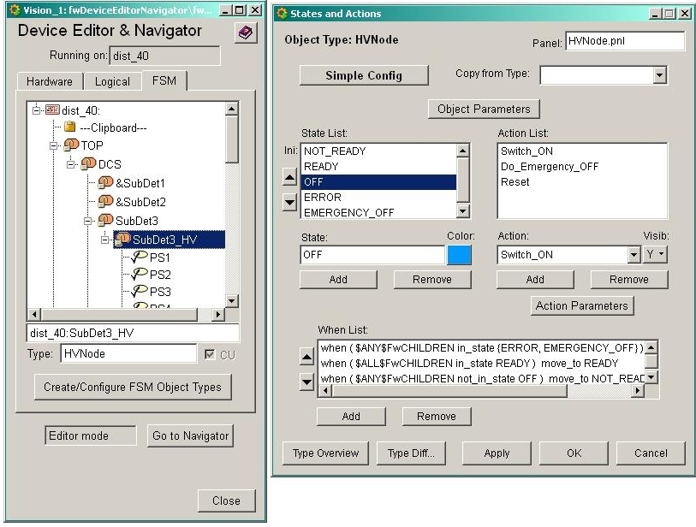
FW – Graphical Editor
SMI++ Objects States & Actions
Parallelism, Synchronization
Asynchronous Rules

Slide 11
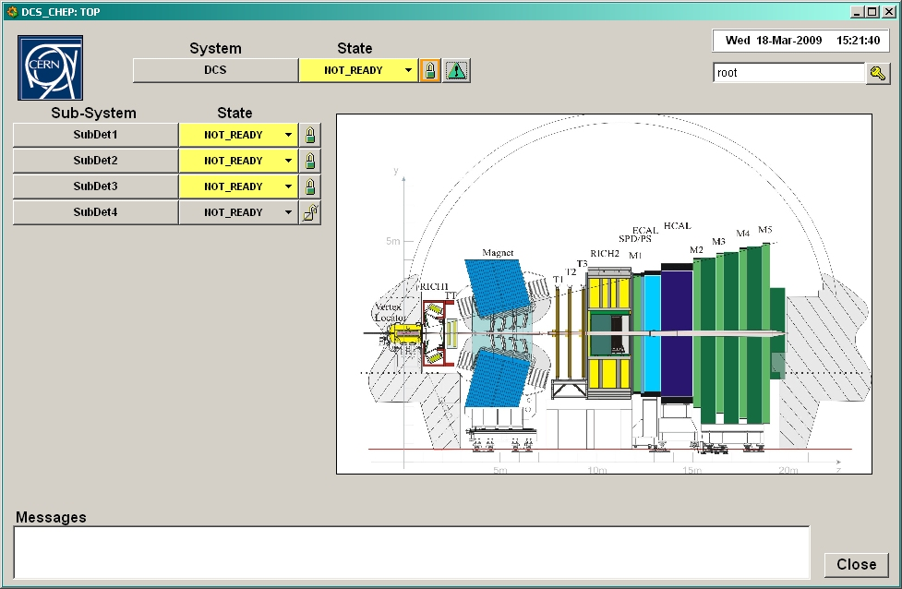
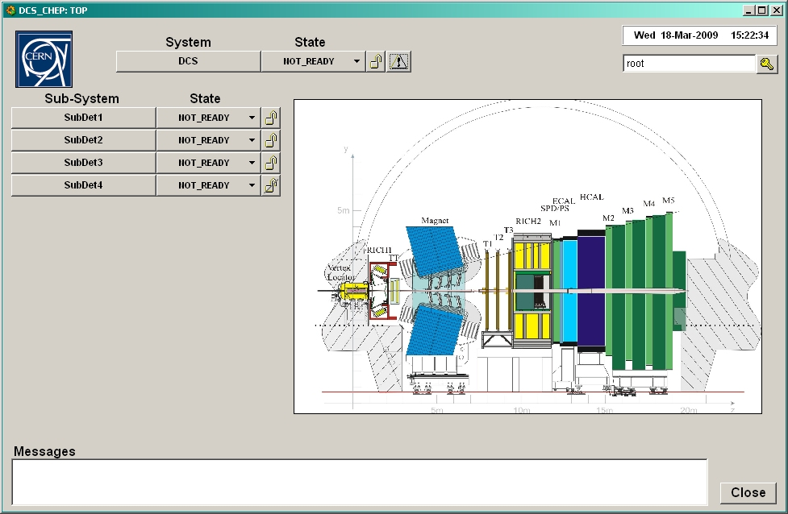
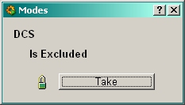
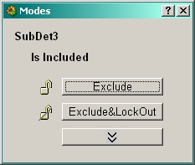
FW - Run-Time
Dynamically generated operation panels (Uniform look and feel)
Configurable User Panels and Logos
“Embedded” standard partitioning rules:
Take
Include
Exclude
Etc.

Slide 12
Operation Domains
DCS Domain Equipment operation related to a running period (Ex: GAS, Cooling)
HV Domain Equipment operation related to the LHC State (Ex: High Voltages)
ERROR
Recover
Switch_OFF
NOT_READY
ERROR
Recover
NOT_READY
OFF
OFF
Go_STANDBY1
Switch_ON
Switch_OFF
RAMPING_STANDBY1
READY
STANDBY1
Go_STANDBY2
DAQ Domain Equipment operation related to a “RUN” (Ex: RO board, HLT process)
RAMPING_STANDBY2
STANDBY2
Go_READY
RAMPING_READY
ERROR
Recover
UNKNOWN
READY
NOT_READY
FSM templates distributed to all Sub-detectors
All Devices and Sub-Systems have been implemented using one of these templates
Configure
CONFIGURING
Reset
READY
Start
Stop
RUNNING

Slide 13
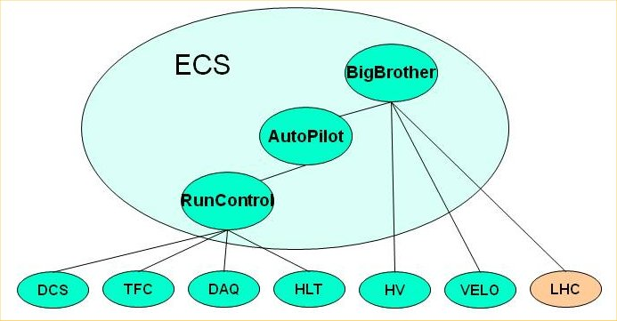
ECS - Automation
Some Examples:
HLT Control (~1500 PCs)
Automatically excludes misbehaving PCs (within limits)
Can (re)include PCs at run-time (they get automatically configured and started)
RunControl
Automatically detects and recovers SubDetector desynchronizations
Can Reset SDs when problems detected by monitoring
AutoPilot
Knows how to start and keep a run going from any state.
BigBrother
Based on the LHC state:
Controls SD Voltages
VELO Closure
RunControl

Slide 14
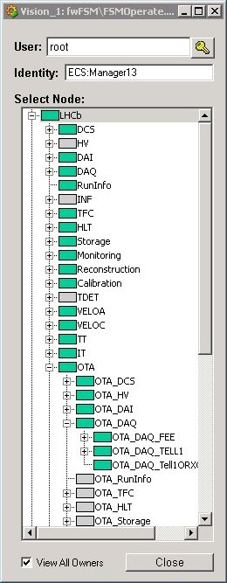
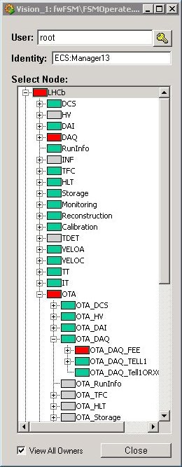
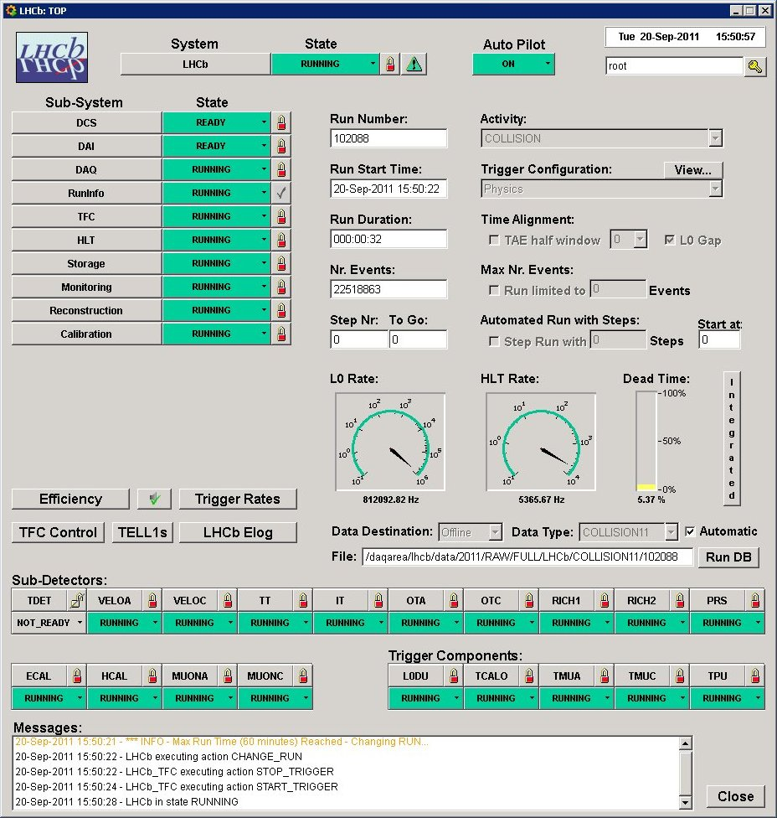
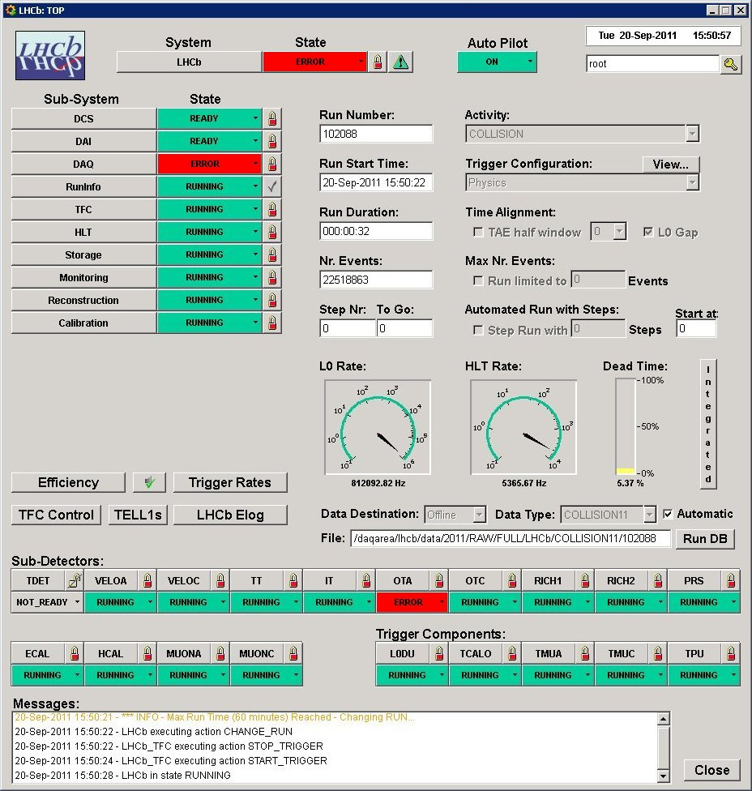
Run Control
Matrix
Activity
Domain
X
Sub-Detector
Used for Configuring all Sub-Systems

Slide 15
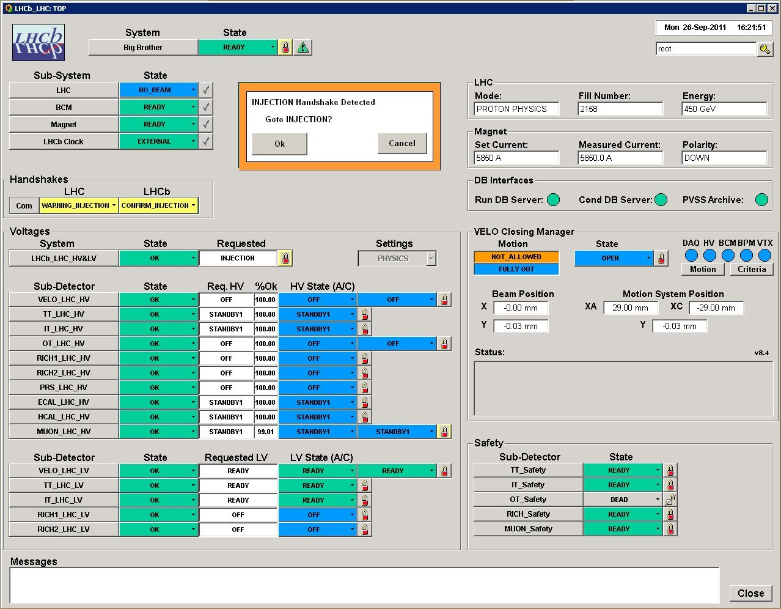
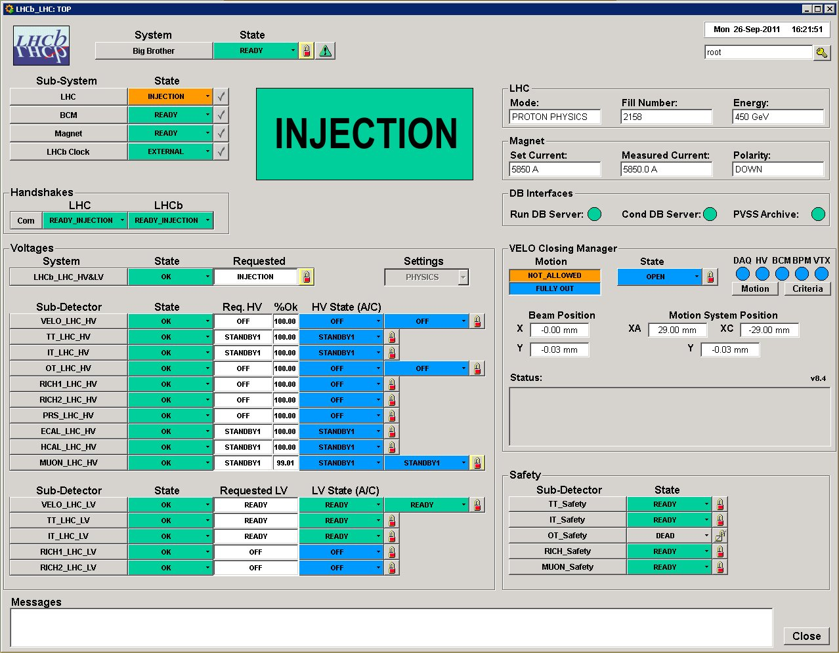
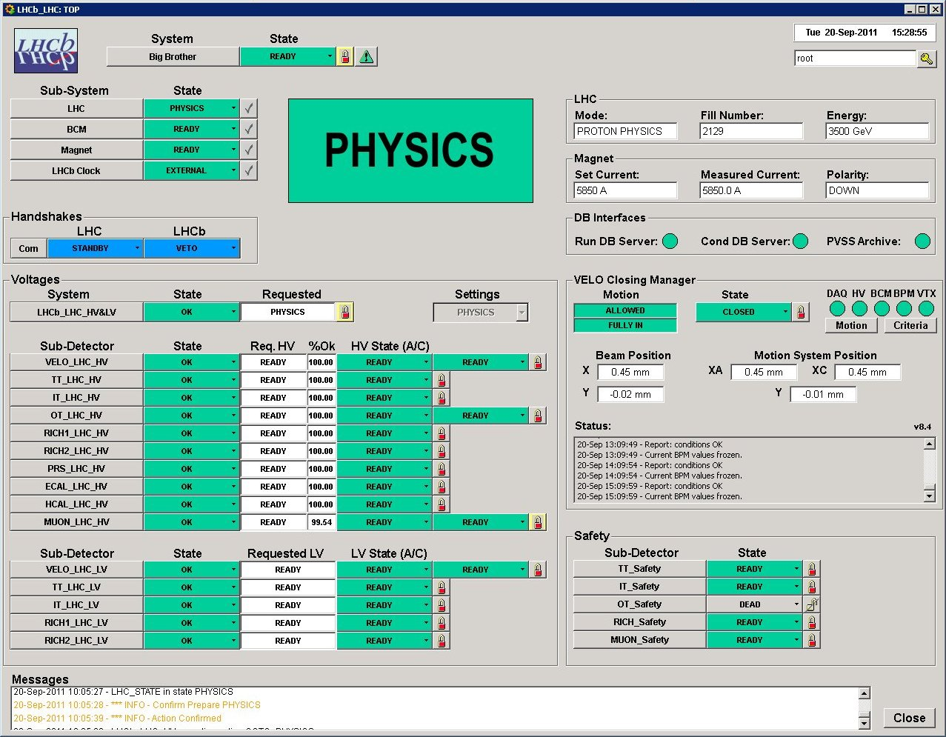
LHCb Operations
Two operators on shift:
Data Manager
Shift Leader has 2 views of the System:
Run Control
Big Brother
Big Brother
Manages LHC dependencies:
SubDetector Voltages
VELO Closing
Run Control

Slide 16
ECS: Some numbers
Size of the Control Tree:
Distributed over ~150 PCs
~100 Linux (50 for the HLT)
~ 50 Windows
>2000 Control Units
>50000 Device Units
Run Control Timing
Cold Start to Running: 4 minutes
Configure all Sub-detectors, Start & Configure ~40000 HLT processes (always done well before PHYSICS)
Stop/Start Run: 6 seconds
ECS
HV
DCS
TFC
DAQ
HLT
LHC
…
…
SubDet1 DCS
SubDetN DCS
SubDet1 DAQ
SubDetN DAQ

Slide 17
ECS Summary
LHCb has designed and implemented a coherent and homogeneous control system
The Experiment Control System allows to:
Configure, Monitor and Operate the Full Experiment
Run any combination of sub-detectors in parallel in standalone
Some of its main features:
Partitioning, Sequencing, Error recovery, Automation
Come from the usage of SMI++ (integrated with PVSS)
LHCb operations now almost completely automated
Operator task is easier (basically only confirmations)
DAQ Efficiency improved to ~98%

Slide 18
SMI++
A Tool for the Automation of large distributed control systems

Slide 19
SMI++
Method
Classes and Objects
Allow the decomposition of a complex system into smaller manageable entities
Finite State Machines
Allow the modeling of the behavior of each entity and of the interaction between entities in terms of STATES and ACTIONS
Rule-based reasoning
React to asynchronous events (allow Automation and Error Recovery)

Slide 20
SMI++
Method (Cont.)
SMI++ Objects can be:
Abstract (e.g. a Run or the DCS System)
Concrete (e.g. a power supply or a temp. sensor)
Concrete objects are implemented externally either in "C", C++, or PVSS
Logically related objects can be grouped inside "SMI domains" representing a given sub-system

Slide 21
SMI++ Run-time Environment
Device Level: Proxies
C, C++, PVSS ctrl scripts
drive the hardware:
deduceState
handleCommands
Abstract Levels: Domains
Internal objects
Implement the logical model
Dedicated language
User Interfaces
For User Interaction
Obj
SMI Domain
Obj
Obj
Obj
Obj
SMI Domain
Obj
Obj
Obj
Proxy
Proxy
Proxy
Hardware Devices

Slide 22
SMI++ - The Language
SML –State Management Language
Finite State Logic
Objects are described as FSMs their main attribute is a STATE
Parallelism
Actions can be sent in parallel to several objects.
Synchronization and Sequencing
The user can also wait until actions finish before sending the next one.
Asynchronous Rules
Actions can be triggered by logical conditions on the state of other objects.

Slide 23
SML example
Device:
Sub System:

Slide 24
SML example (many objs)
Devices:
Sub System:
Objects can be dynamically included/excluded in a Set

Slide 25
SML example (automation)
Objects in different domains can be addressed by: <domain>::<object>
External Device:
Sub System:

Slide 26
SMI++ Run-time Tools
Device Level: Proxies
C, C++, PVSS ctrl scripts
Use a Run Time Library: smirtl To Communicate with their domain
Abstract Levels: Domains
A C++ engine: smiSM - reads the translated SML code and instantiates the objects
User Interfaces
Use a Run Time Library: smiuirtl To communicate with the domains
All Tools available on:
Windows, Unix (Linux), etc.
All Communications are dynamically (re)established
Obj
SMI Domain
Obj
Obj
Obj
Obj
SMI Domain
Obj
Obj
Obj
Proxy
Proxy
Proxy
Hardware Devices

Slide 27
SMI++ History
1989: First implemented for DELPHI in ADA Thanks to M. Jonker and B. Franek in Delphi and the CERN DD/OC group (S. Vascotto, P. Vande Vyvre et al.)
DELPHI used it in all domains: DAQ, DCS, Trigger, etc.
A top level domain: Big-Brother automatically piloted the experiment
1997: Rewritten in C++
1999: Used by BaBar for the Run-Control and high level automation (above EPICS)
2002: Integration with PVSS for use by the 4 LHC exp.
Has become a very powerful, time-tested, robust, toolkit

Slide 28
Features of SMI++
Task Separation:
SMI Proxies execute only basic actions – Minimal intelligence
Good practice: Proxies know “what” to do but not “when”
SMI Objects implement the logic behaviour
Advantages:
Change the HW -> change only the Proxy
Change logic behaviour sequencing and dependency of actions, etc -> change only SMI rules

Slide 29
Features of SMI++
Sub-system integration
SMI++ allows the integration of components at various different levels:
Device level (SMI++ All the way to the bottom)
Each Device is modeled by a Proxy
Any other higher level (simple SMI++ interface)
A full Sub-system can be modeled by a Proxy
Examples:
The Gas Systems (or the LHC) for the LHC experiments
Slow Control Sub-systems (EPICS) in BaBar

Slide 30
Features of SMI++
Distribution and Robustness:
SMI Proxies and SMI domains can run distributed over a large number of heterogeneous machines
If any process dies/crashes/hangs:
Its “/dead_state” is propagated as current state
When a process restarts (even on a different machine)
All connections are dynamically re-established
Proxies should re-calculate their states
SMI Objects will start in “/initial_state” and can recover their current state (if rules are correct)

Slide 31
Features of SMI++
Error Recovery Mechanism
Bottom Up
SMI Objects react to changes of their children
In an event-driven, asynchronous, fashion
Distributed
Each Sub-System can recover its errors
Normally each team knows how to recover local errors
Hierarchical/Parallel recovery
Can provide complete automation even for very large systems

Slide 32
Conclusions
SMI++ is:
A well tested, and very robust tool
Not only a Finite State Machine toolkit
But has also “Expert System” capabilities
Advantage: Decentralized and distributed knowledge base
Heavily used in BaBar and by the 4 LHC experiments (they depend on it)

Slide 33
Spare slides

Slide 34
SMI++ Declarations
Classes, Objects and ObjectSets
class: <class_name> [/associated]
<parameter_declaration>
<state_declaration>
<when_list>
<action_declaration>
<instruction_list>
…
object: <object_name> is_of_class <class_name>
objectset: <set_name> [{obj1, obj2, …, objn}]

Slide 35
SMI++ Parameters
<parameters>
SMI Objects can have parameters, ex:
int n_events, string error_type
Possible types:
int, float, string
For concrete objects
Parameters are set by the proxy (they are passed to the SMI domain with the state)
Parameters are a convenient way to pass extra information up in the hierarchy

Slide 36
SMI++ States
state: <state_name> [/<qualifier>]
<qualifier>
/initial_state For abstract objects only, the state the object takes when it first starts up
/dead_state For associated objects only, the state the object takes when the proxy or the external domain is not running

Slide 37
SMI++ Whens
<when_list>
Set of conditions that will trigger an object transition. "when"s are executed in the order they are declared (if one fires, the others will not be executed).
state: <state>
when (<condition>) do <action>
when (<condition>) move_to <state>

Slide 38
SMI++ Conditions
<condition>
Evaluate the states of objects or objectsets
(<object> [not_]in_state <state>)
(<object> [not_]in_state {<state1>, <state2>, …})
(all_in <set> [not_]in_state <state>)
(all_in <set> [not_]in_state {<state1>, <state2>, …})
(any_in <set> [not_]in_state <state>)
(any_in <set> [not_]in_state {<state1>, <state2>, …})
(<condition> and|or <condition>)

Slide 39
SMI++ Actions
action: <action_name> [(parameters)]
If an object receives an undeclared action (in the current state) the action is ignored.
Actions can accept parameters, ex:
action: START_RUN (string run_type, int run_nr)
Parameter types:
int, float and string
If the object is a concrete object
The parameters are sent to the proxy with the action
Action Parameters are a convenient way to send extra information down the hierarchy

Slide 40
SMI++ Instructions
<instructions>
<do>
<if>
<move_to>
<set_instructions>
insert <object> in <set>
remove <object> from <set>
<parameter_instructions>
set <parameter> = <constant>
set <parameter> = <object>.<parameter>
set <parameter> = <action_parameter>

Slide 41
SMI++ Instructions
<do> Instruction
Sends a command to an object.
Do is non-blocking, several consecutive "do"s will proceed in parallel.
do <action> [(<parameters>)] <object>
do <action> [(<parameters>)] all_in <set>
examples:
do START_RUN (run_type = "PHYSICS", run_nr = 123) X
action: START (string type)
do START_RUN (run_type = type) EVT_BUILDER

Slide 42
SMI++ Instructions
<if> Instruction
"if"s can be blocking if the objects involved in the condition are "transiting". The condition will be evaluated when all objects reach a stable state.
if <condition> then
<instructions>
else
<instructions>
endif

Slide 43
SMI++ Instructions
<move_to> Instruction
"move_to" terminates an action or a when statement. It sends the object directly to the specified state.
action: <action>
…
move_to <state>
when (<condition>) move_to <state>

Slide 44
Future Developments
SML Language
Parameter Arithmetics
set <parameter> = <parameter> + 2
if (<parameter> == 5)
wait(<obj_list)
for instruction
for (dev in DEVICES)
if (dev in_state ERROR) then
do RESET dev
endif
endfor

Slide 45
SML – The Language
An SML file corresponds to an SMI Domain. This file describes:
The objects contained in the domain
For Abstract objects:
The states & actions of each
The detailed description of the logic behaviour of the object
For Concrete or External (Associated) objects
The declaration of states & actions

