Slide 1

LHCb Operations in Run I:
Challenges and lessons learnt

Slide 2
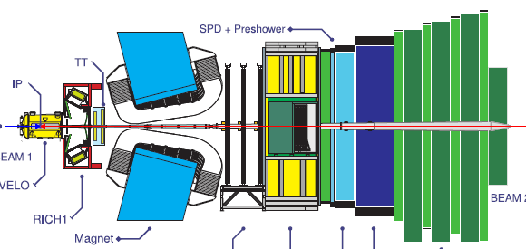
Operations
Operations Strategy
  2 people on shift (from day one)
    1 Shift Leader (and main operator)
    1 Data Quality Manager
    and small on-call team: ~10 people
  Integrated Control System
    Homogeneous User Interfaces to all areas:
      Data Acquisition (DAQ), Detector Control System (DCS), Trigger, High Level Trigger (HLT), etc.
  Full Automation
    For standard procedures and (known) error recovery

Slide 3
Operations Scope
Detector & General Infrastructure (Power, Gas, Cooling, etc.)
Detector Channels
Trigger
Timing
Front End Electronics
Experiment Control System
Readout Boards
High Level Trigger (Farm)
Storage
Offline
Processing
Monitoring
DAQ
External Systems (LHC, Technical Services, Safety, etc.)

Slide 4
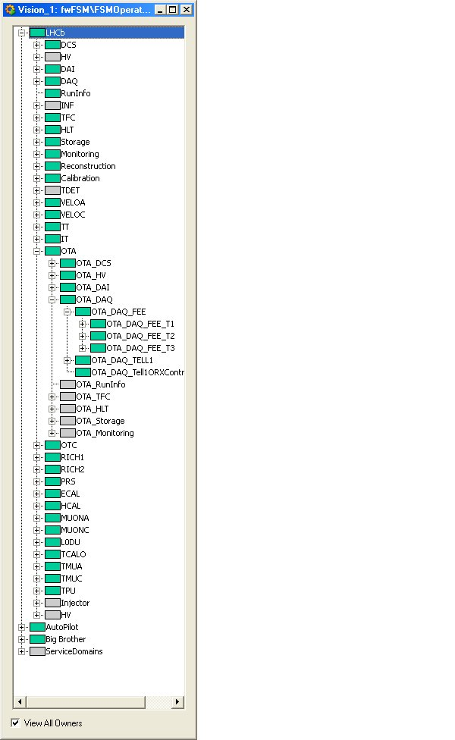
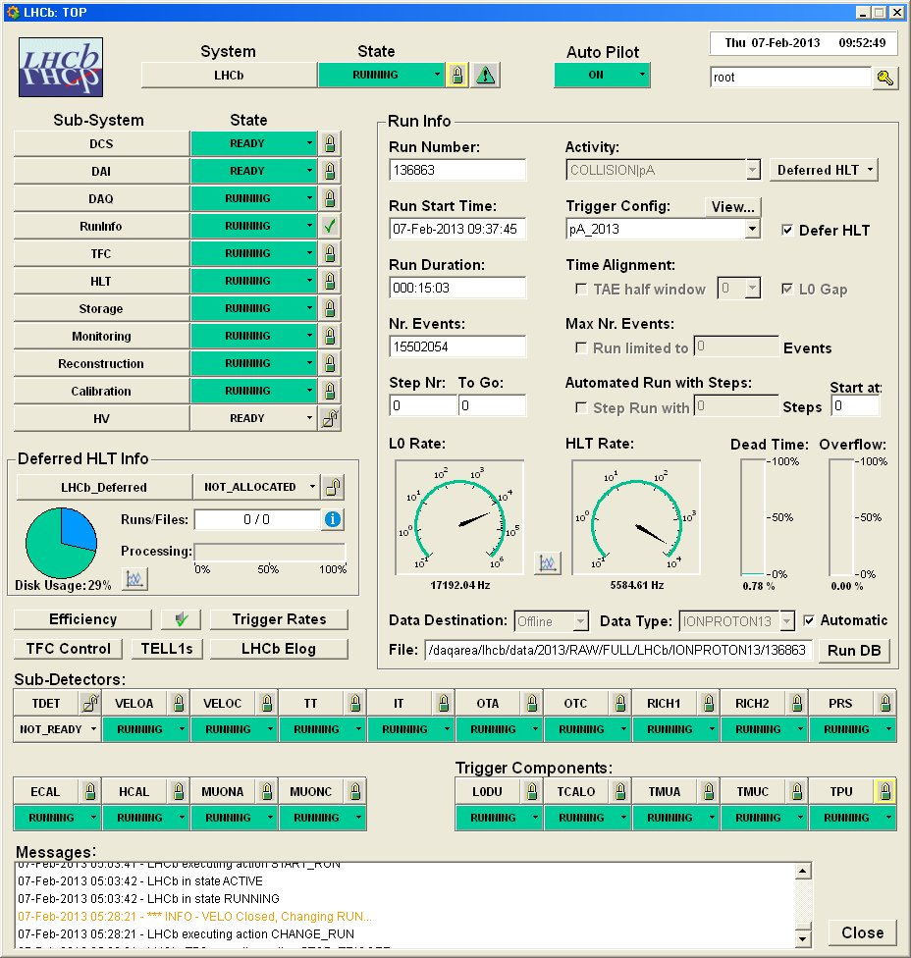
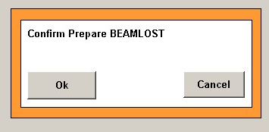
Operations Tools
Run Control Automation: The Autopilot
  Configures, Starts and Keeps the RUN going.
  Recovers:
  Sub-detector
  de-synch.
  Misbehaving farm nodes
  Etc.

Slide 5
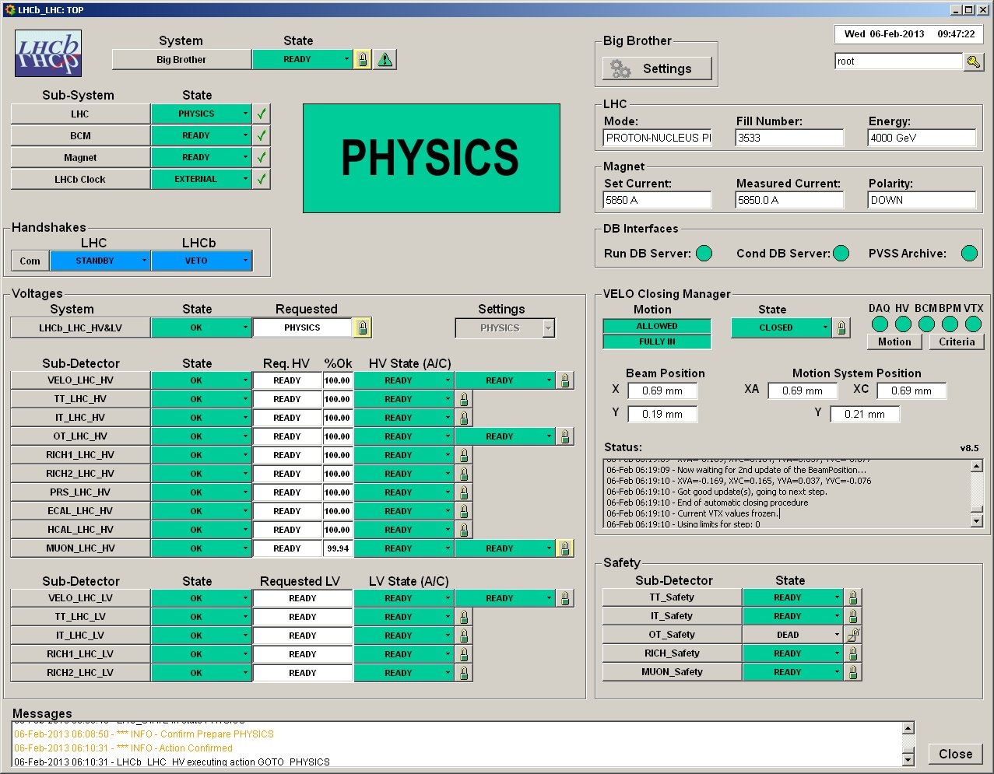
Operations Tools
Big Brother
Based on LHC state, controls:
  Voltages
  VELO Closure
  Run Control
Can sequence activities, ex.:
  End-of-fill Calibration
Confirmation requests and Information
  Voice Messages

Slide 6

Selected Challenges…

Slide 7

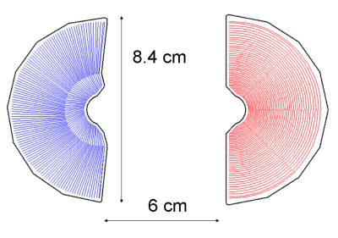

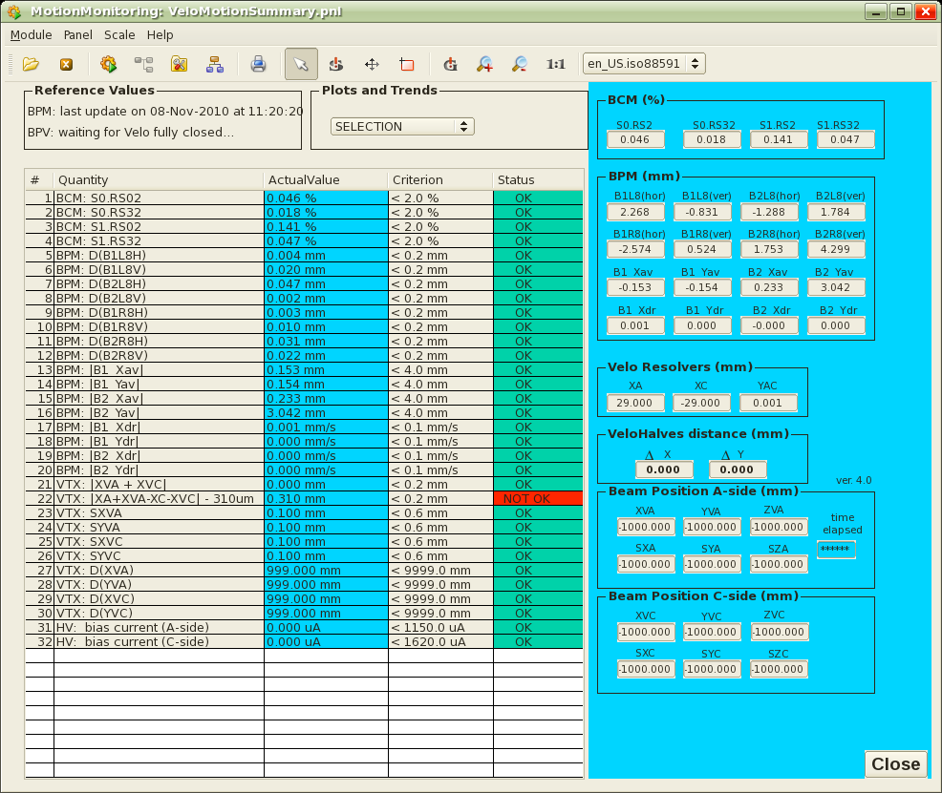
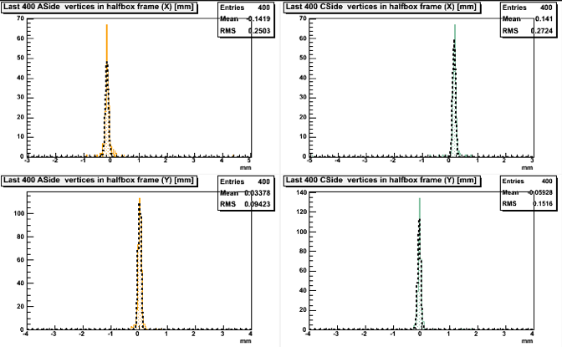
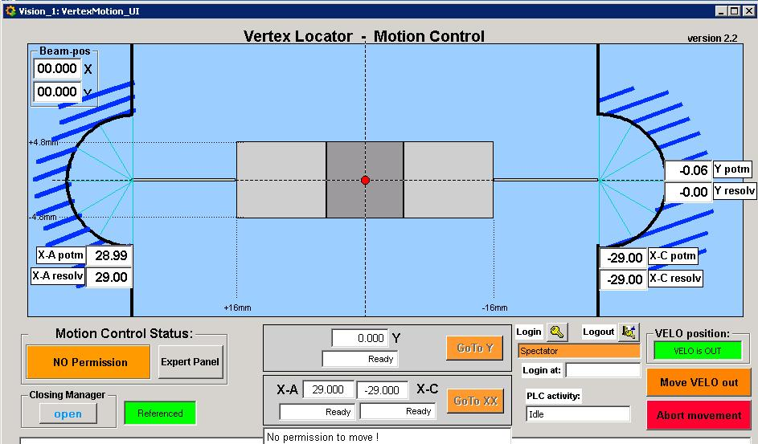
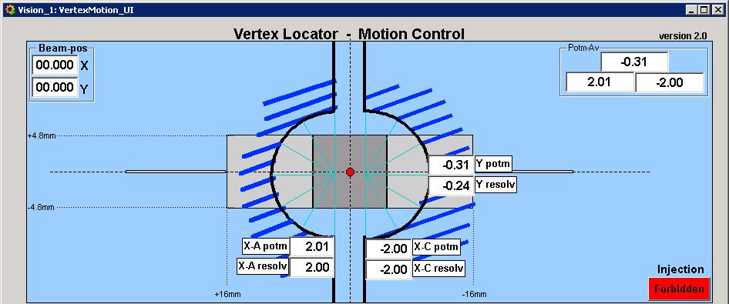
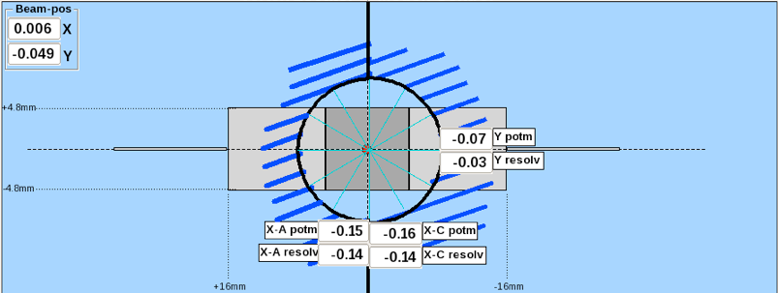
VELO Closing
Safety: Many criteria to respect
Procedure: Iterative “Feedback” loop
Big Brother
Take data
(DAQ)
3D Vertex Reconstruction
(HLT Farm)
Calculate next VELO position
(Monitoring Farm)
Move VELO
(DCS)

Slide 8
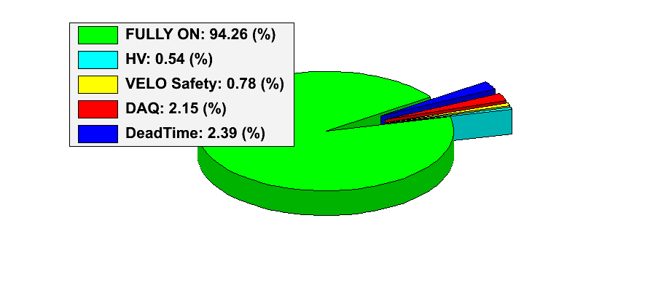
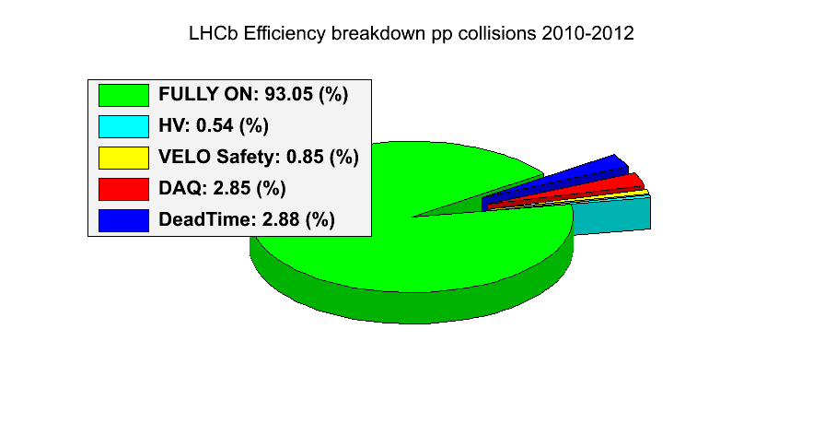
VELO Closing
Manually operated in the beginning
Completely automated since 2011
  Takes ~4 minutes at start of fill
LHCb Efficiency breakdown 2012

Slide 9
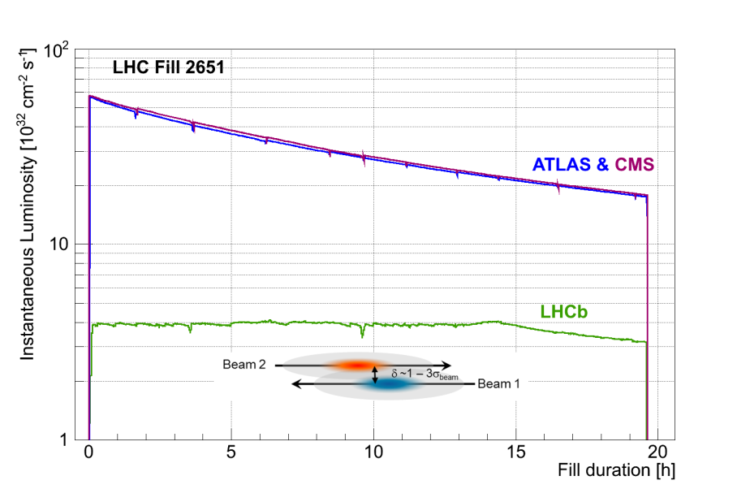
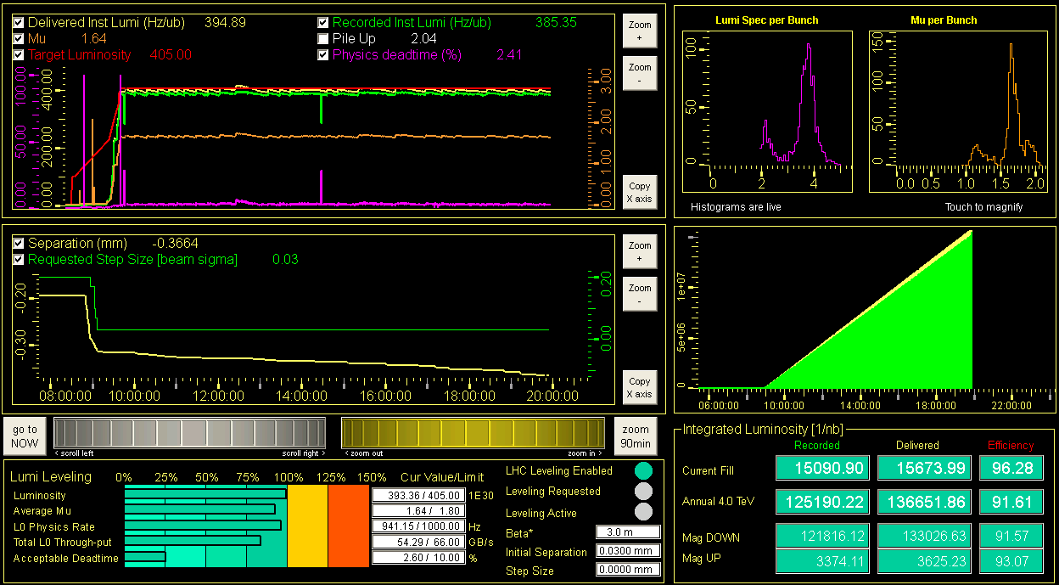
Luminosity Levelling
Allows running LHCb under stable optimum conditions
Constraints: Safety and Reliability
LHCb
LHCb Leveling GUI
Configuration & Monitoring
LHC
Control
System
CERN data exchange protocol (TCP/IP)
Lumi controller
Instant Lumi
Target Lumi
Levelling Request
Step Size
Levelling Enabled
Levelling Active
…
LHCb
readout system
LHCb Luminosity
detectors

Slide 10
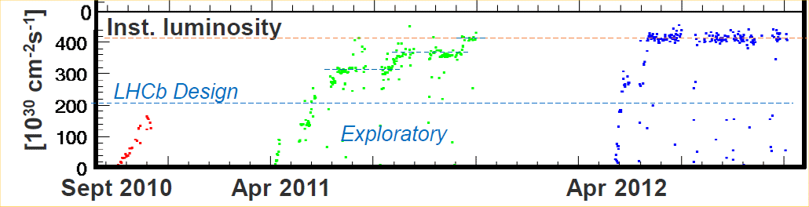
Luminosity Levelling
In operation since 2011
95 % of integrated luminosity recorded within 3% of desired luminosity
Thanks to the LHC experts and operators

Slide 11
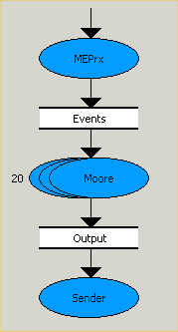
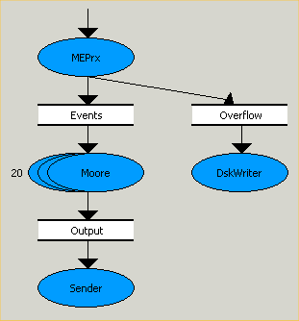
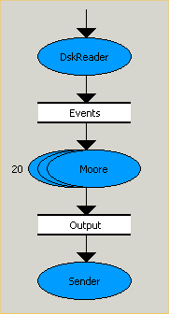
HLT Farm Usage
Resource Optimization -> Deferred HLT
  Idea: Buffer data to disk when HLT busy / Process in inter-fill gap
  Change of “paradigm”: A run can “last” days…
Standard HLT
Deferred HLT
1 MHz
Farm Node
Farm Node during Physics
Farm Node Inter-fill
Farm Node
Farm Node
EvtBuilder
EvtBuilder
HLT
70 KHz
HLT
HLT
5 KHz

Slide 12
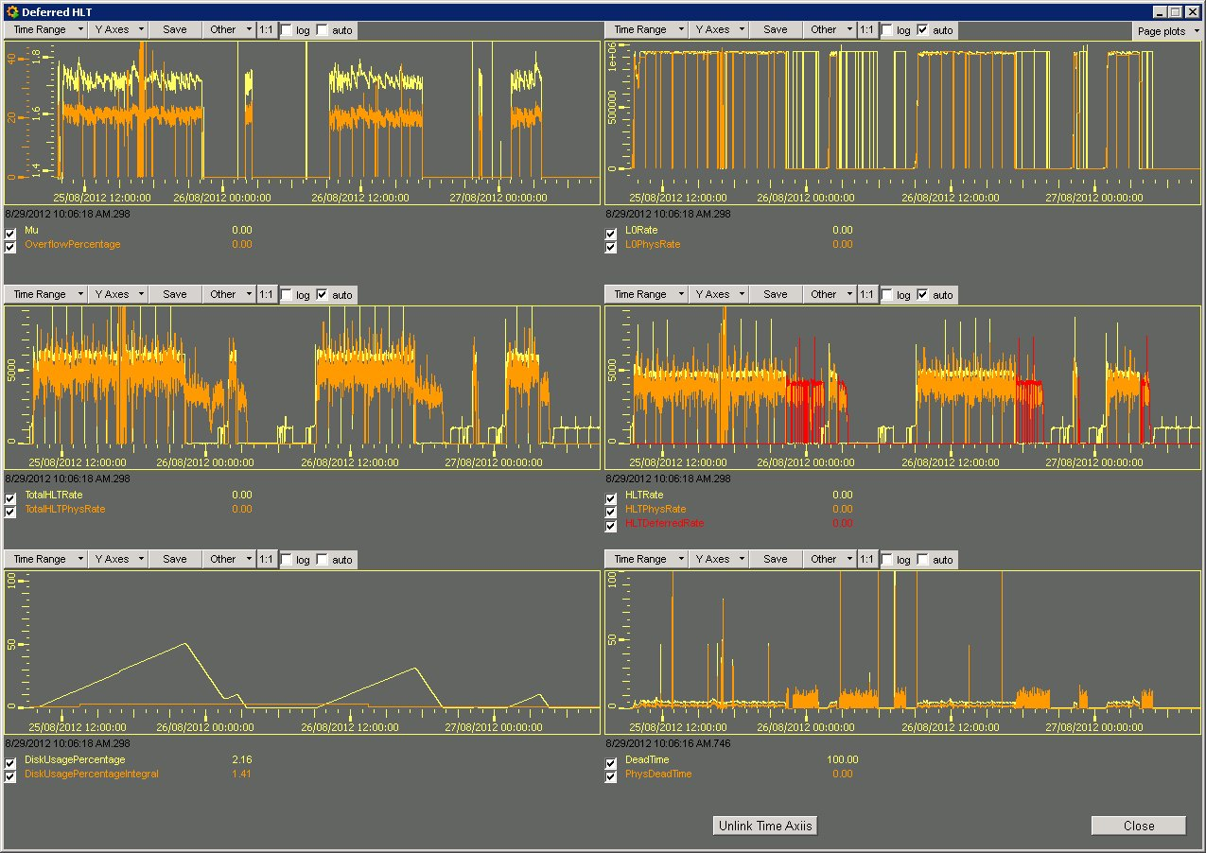
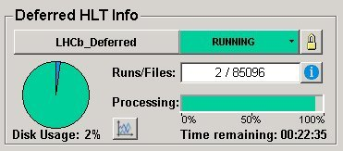
Deferred HLT
Major Success
  In place since 2012
  ~20% resource gain for HLT
    Better Trigger
  Cushion for central DAQ/Storage hiccups

Slide 13
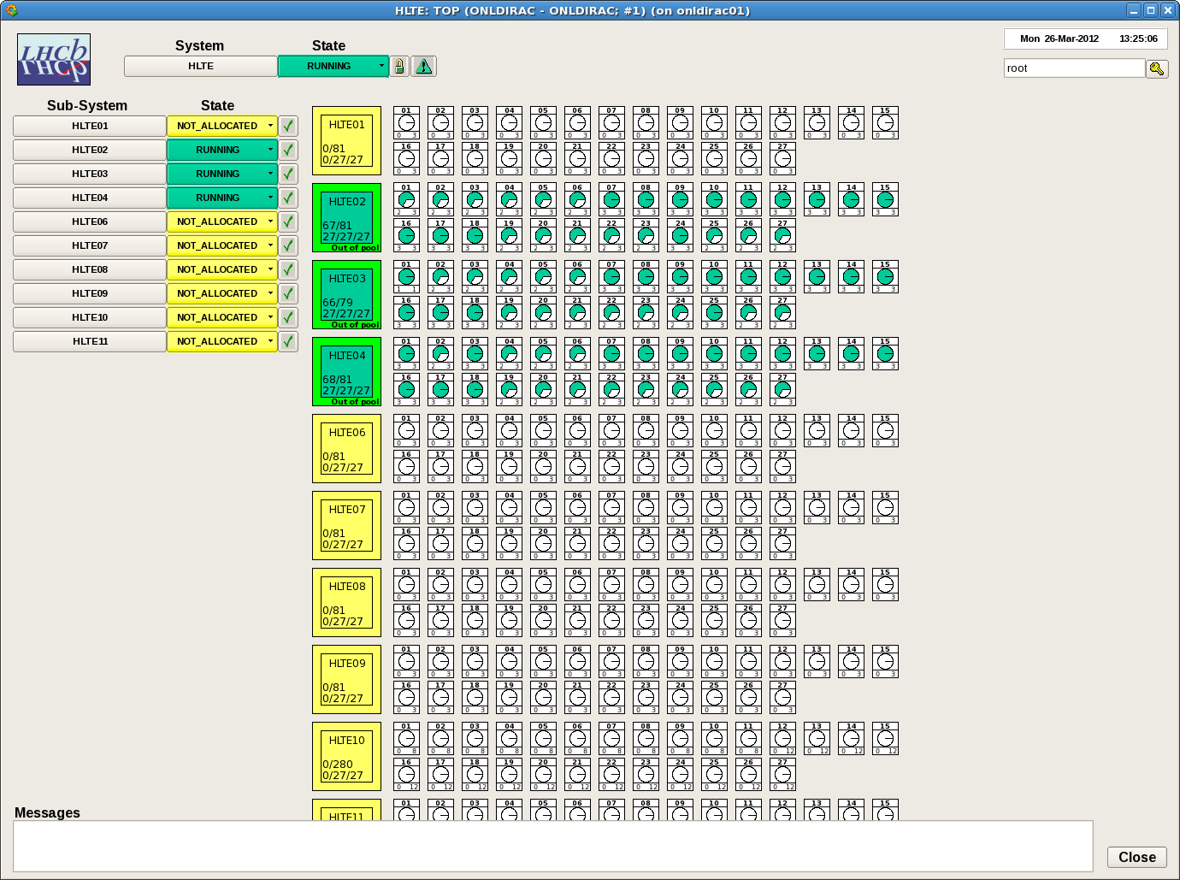
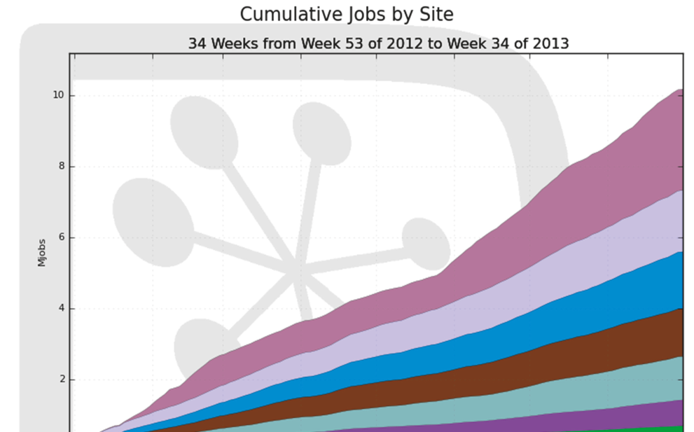
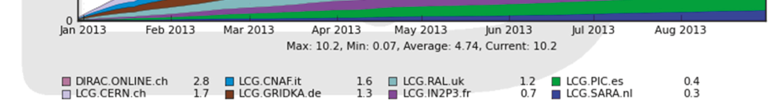
HLT Farm Usage
Resource Optimization -> Offline Processing
  Idea: Run standard Offline Simulation outside data taking periods
  Online Control System turns HLT Farm into Offline site
  In Operations since end 2012
Also a big Success:
  ~25K jobs simultaneously
  Largest LHCb producer

Slide 14
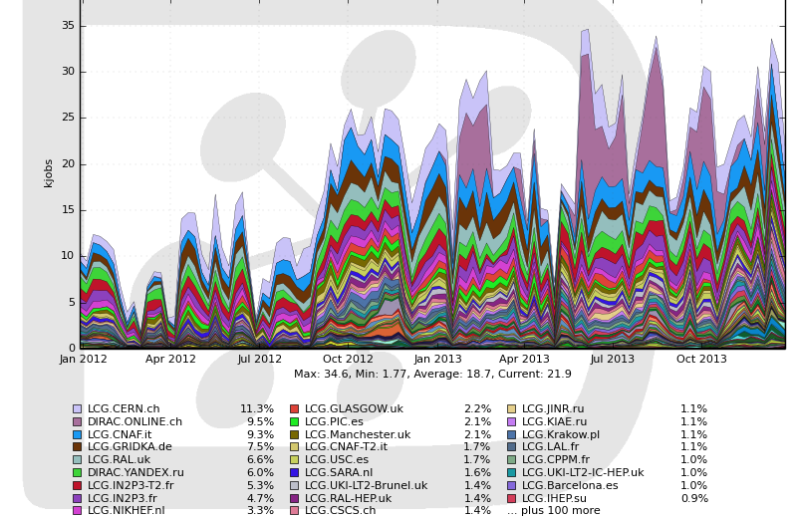
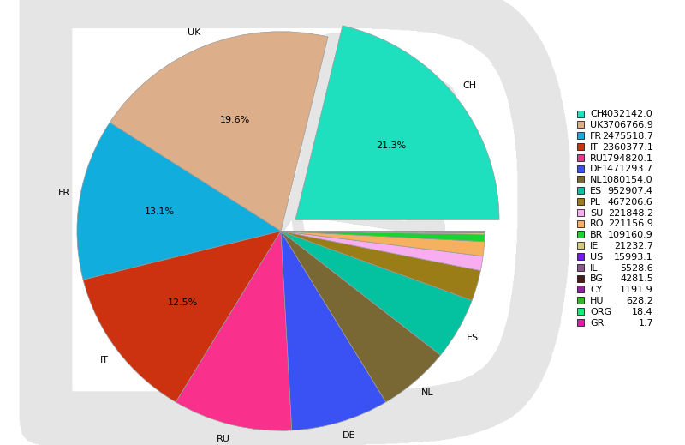
Distributed Computing
From Online
Full Stream
5 KHz
From Online
Express Stream
5 Hz
Running Jobs since 2012
Storage
(CASTOR)
Storage
(CASTOR)
Generation
GRID
CERN
Reconstruction
Reconstruction
Stripping
Data Quality
Calibration
&
Alignment
Data Quality
Analyses
CPU Usage since 2012
Conditions
DB
Running Fine
  126 sites in 20 countries
  2 Shifters (daytime only)

Slide 15

Lessons Learnt…

Slide 16

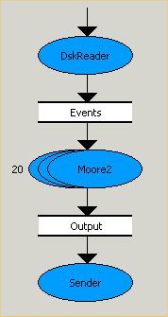
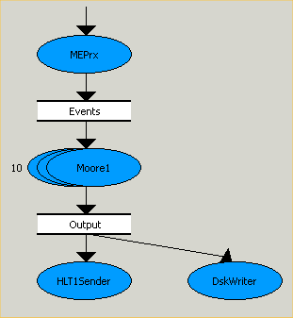
HLT Farm Usage in RUN II
Even better Resource Optimization -> Split HLT
  Idea: Buffer ALL data to disk after HLT1 / Perform Calibration & Alignment / Run HLT2 permanently in background
1 MHz
Farm Node
EvtBuilder
Selected
Events
Calib&Align
Local disk
Buffer
HLT1
HLT2
100 KHz
100%
For DQ only
12.5 KHz
Conditions
DB

Slide 17
Summary
LHCb Operations very successful
The strategy was good
  One operator is enough
  Integration & Homogeneity
    Allows complex feedback mechanisms
      Ex.: Re-synch or Reset a Sub-detector
      from Data Monitoring information
  Automated Operations
    Saves time and avoids mistakes
    But requires experience and learning…
  Further improve HLT Farm usage
    Better Trigger and Online processing closer to Offline
Related talks:
  LHCb Run I Performance: Giacomo Graziani, Monday morning
  LHCb Run II Challenges: Karol Hennessy, Friday afternoon
  LHCb Upgrades: Olaf Steinkamp, Friday afternoon
LHCb Efficiency breakdown
pp collisions 2010-2012
99% channels working
99% good data for analysis

